Slide 1
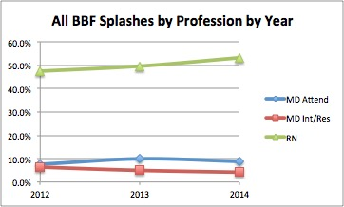
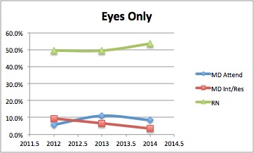
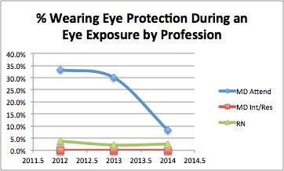
Blood and Body Fluid Eye Exposure Risk on the Rise
Amber Hogan Mitchell, DrPH, MPH, CPH | President & Executive Director, International Safety Center
Ginger B. Parker, MBA, Chief Information Officer, International Safety Center
BACKGROUND
METHODS
RESULTS
DISCUSSION
Safe healthcare is a balance of managing patients with known or suspected infectious disease with the health and welfare of its workforce.
Occupational risks associated with blood/body fluid (BBF) exposures compared to needlesticks are often under-represented and can carry higher risk due to the ability for more than just bloodborne pathogens to be transmitted.
With the influx of emerging infectious disease, it becomes increasingly important to identify where high risk exposures are happening so that we can prevent them.
This study quantifies three years (2012-2014) of the International Safety Center's Exposure Prevention Information Network (EPINet®) surveillance data in 30 US hospitals.
Data is from occupational incidents reported to employee health for mucocutaneous exposures, especially those to the highest risk body location—the eyes.
Data compares all BBF exposures, eye only exposures, and eye protection/PPE use over the study period.
It also compares these rates among nurses versus physicians (attending or training).
All BBF incidents changed over the study time period; 175 (2012), 141 (2013), 216 (2014) for all exposures and 105, 91, 142 to eyes only.
The eyes represent more than 60% of all BBF exposures.
The percent of staff wearing eye protection/PPE changed from 8.0% in 2012, up to 12.8% in 2013, and down to 2.8% in 2014.
BBF eye exposure incidents were far higher for nurses (47.4-53.2%) compared to physicians (13.0-14.9%), yet nurses wore eyewear even less often (2.2-3.8%) than physicians (8.3-33.4%).
Not only are eye exposures on the rise, but PPE use and compliance are on the decline among physicians and nurses.
Given their greater incident rate, a low level of eyewear use is even more dangerous to nurses.
This data illustrates a discouraging trend with occupational risk on the rise at a time where emerging infectious disease threats and pressure to see more patients are high.
Measuring these types of exposures is important so we can put protections in place - including access to and use of eye protection - that prevent occupational illness and infection.
amber.mitchell@internationalsafetycenter.org
Presented to the AOHP 2016 National Conference, September 7-10, 2016, Myrtle Beach, SC

